Slide 1
Claude Code with Opus 4.5
By Alex Finn
https://www.youtube.com/watch?v=UVJXh57MgI0

Slide 2


Slide 3
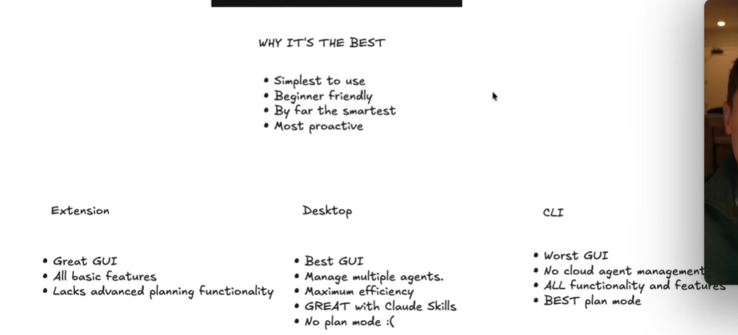

Slide 4
How to run Claude Code in VS Code?
In the new terminal, simply type, claude, then hit enter

Slide 5
Plan mode (Shift + tab)
Key Components of the Prompt:
Target Audience: "Vibe coders" [09:47].
Core Features: A Kanban board, a side-by-side to-do list, and a note-taking area [09:47, 09:52].
Specific Functionality: Drag-and-drop cards with standard status columns (To Do, In Progress, Complete) [09:52, 09:57].
Design Preference: A clean, simple dark mode interface that avoids a typical "AI-generated" look [09:57, 10:03].
Technical Stack: Next.js for the framework and local storage for data persistence (before moving to a full database later) [10:12, 10:20].
Prompt:
I want to build a project management app for vibe coders. It should be a Kanban board that also has a to-do list next to it and a note-taking area. The Kanban board should have 'To Do', 'In Progress', and 'Complete' and have cards for the tasks you can drag and move around. Make it a clean, simple dark mode interface that doesn't look AI-generated. I also want to use Next.js for this and local storage.

Slide 6
Front-end design skill
How Alex uses it in the video:
Installation: He installs the skill using two specific terminal commands (which he links in his description) [15:04, 15:22].
Redesigning: Once installed, he simply tells Claude: "Redesign my UI using the new design skill." [15:36]
Transformation: Claude then rebuilds the entire interface of his project management app to be "beautiful," professional, and modern-looking [14:19, 15:43].
these types of skills are a powerful feature of the Claude Code CLI that other AI tools don't currently offer, making it the best choice for building production-ready apps
a specialized Claude Skill (essentially a plugin) that transforms Claude into a design expert
What it is and What it Does:
The Problem: Without this skill, AI-generated apps often look "ugly" or generic, with outdated gradients and poor layouts [15:43].
The Solution: This skill teaches Claude the principles of modern, professional UI (User Interface) design [15:13].
The Result: It allows Claude to build interfaces that are clean, simple, and look like they were made by a high-end designer (e.g., modern fonts and "linear-style" aesthetics) rather than an AI [14:24, 15:55].

Slide 7
Two commands for Claude Code Front-end skill
/plugin marketplace add anthropics/claude-code
/plugin install frontend-design@claused-code-plugins

Slide 8
Flowstate

Slide 9
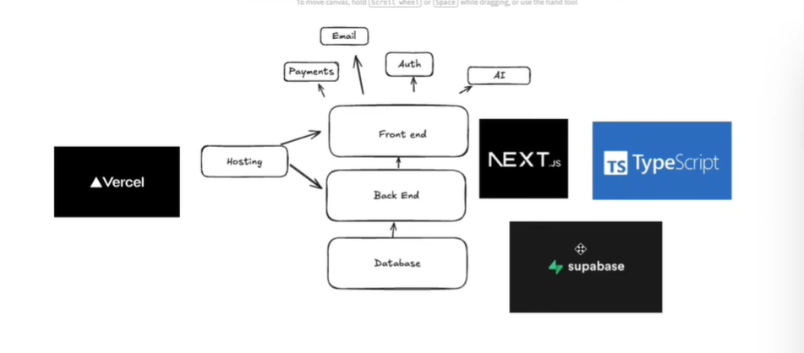

Slide 10
What is Vercel?
Vercel is a cloud platform designed to make it incredibly easy for developers to deploy and host the "front-facing" parts of a website (the frontend) [1.1, 1.3]. While it's best known as the creator and maintainer of Next.js, it supports almost any modern web framework like React, Vue, Svelte, and Astro [1.2].
Think of it as the bridge between your code (on GitHub) and a live website that users can actually visit.
How It Works
Vercel automates the entire deployment process. You don't have to manually set up servers or networking [1.1].
Git Integration: You connect your GitHub, GitLab, or Bitbucket account to Vercel [1.3].
Auto-Deployment: Every time you "push" new code to your repository, Vercel automatically detects the changes, builds your project, and updates your live site in seconds [1.2, 1.3].
Global Network: Vercel places your website on a Global Edge Network. This means your site's files are stored on servers all over the world, so they load instantly for a user whether they are in New York, London, or Tokyo [1.2, 2.3].2. Key Features

Slide 11
2. Key Features
Preview Deployments: Every time you propose a change (a "Pull Request"), Vercel generates a unique temporary URL. This lets your team or clients see and test exactly what the new version looks like before it goes live [2.3].
Serverless Functions: Although Vercel focuses on the frontend, it allows you to run "backend" code (like processing a login or a payment) using Serverless Functions. You don't manage a server; the code just "runs" when needed and scales automatically [1.2, 2.5].
v0 & AI Tools: Vercel has recently expanded into AI. Their tool v0 allows you to describe a website in plain English, and the AI will generate the code and deploy it for you instantly on Vercel [1.4, 4.2].
3. Pricing: Vercel uses a "Hobby to Enterprise" model [4.1]:
Hobby (Free): Perfect for personal projects and small apps. Includes automatic CI/CD and basic usage limits [4.1, 4.2].
Pro ($20/month): Designed for professional teams. It offers higher usage limits, team collaboration tools, and faster builds [4.1, 4.3].
Enterprise: Custom pricing for large companies requiring advanced security, compliance (like HIPAA), and dedicated support [4.1, 4.2].

Slide 12
Vercel vs. Competitors
Feature | Vercel | Netlify | AWS Amplify
Best For | Next.js & Dynamic Apps | Static Sites & Composable Apps | Complex Enterprise Backends
Setup | Zero-config (easiest) | Low-config | High-config (requires AWS expertise)
Key Advantage | Superior SSR & ISR performance | Great built-in forms & identity | Infinite scalability within AWS
how to connect your GitHub account to Vercel and deploy your first project?

Slide 13
What is next.js?
Next.js is a powerful full-stack web development framework built on top of React [1.2, 1.3]. While React is a library focused on building user interfaces, Next.js provides the extra structure and "production-ready" features needed to build complete, fast, and SEO-friendly applications [1.3, 3.1]. (Search Engine Optimization)
Created and maintained by Vercel, it is widely considered the industry standard for modern React development [1.2, 1.3].
Why do developers use Next.js instead of just React?
In a standard React app, the browser receives a nearly empty HTML file and has to build the page using JavaScript (Client-Side Rendering). This can lead to slow initial loads and poor SEO [3.4, 3.5]. Next.js solves this by offering Pre-rendering [2.1]

Slide 14
Core Features & Benefits
Hybrid Rendering: You can choose how each individual page is rendered
Static Site Generation (SSG): Generates pages at "build time." These are lightning-fast because they are served as static files from a global CDN [4.1, 4.3].
Server-Side Rendering (SSR): Generates a fresh page on every request. This is ideal for personalized data or real-time content (like a user dashboard) [4.3, 4.5].
Incremental Static Regeneration (ISR): Allows you to update static pages after you’ve built your site, without needing a full rebuild [4.1, 4.4].
File-based Routing: You don't need to write complex code to manage URLs. Simply adding a file to the app or pages folder automatically creates a new route (e.g., about.js becomes yourdomain.com/about)
Automatic Optimizations: It includes built-in tools for Image Optimization (resizing and lazy loading), Font Optimization, and Fast Refresh for a smooth development experience
Full-Stack Capabilities: You can write both your frontend and backend (API routes) in the same project, making it a "one-stop shop" for web apps

Slide 15
Comparison
Feature | Standard React | Next.js
Category | JavaScript Library | Full-Stack Framework
Rendering | Client-side only (by default) | SSR, SSG, ISR, and CSR
SEO | Harder to optimize | Excellent out-of-the-box
Routing | Requires extra libraries (React Router) | Built-in (file-based)
Performance | Depends on client device | High (server-side power)
Next.js is the preferred choice for E-commerce sites, Marketing pages, and Blogs where speed and Google rankings (SEO) are critical [1.3, 1.4]. It is also great for large-scale enterprise applications that need to stay organized as they grow
Check out this introductory guide to Next.js for a quick visual summary of these core benefits. This video is relevant as it provides a concise, beginner-friendly overview of how Next.js enhances React by adding server-side power and zero-config routing

Slide 16
What is Supabase
a powerful "Backend-as-a-Service" (BaaS) platform that allows you to build and host the back end of your web or mobile applications without having to manage servers yourself.
It is widely known as the open-source alternative to Firebase. While Firebase uses a NoSQL (document-style) database, Supabase is built on PostgreSQL, a robust and popular relational database that uses SQL

Slide 17
Core Components
Supabase provides a "full-stack" toolkit that gives you everything you need for a modern app out of the box:
Database (PostgreSQL): A full relational database where your data lives. You can write complex queries, use joins, and define relationships between tables [1.3, 2.3].
Authentication: A built-in user management system. It supports email/password logins, magic links, and social logins (Google, GitHub, Facebook, etc.) [1.3, 2.2].
Realtime: This allows you to "listen" to changes in your database. If someone updates a row, your app can automatically show the new data without the user refreshing the page [1.3, 1.5].
Storage: A place to store large files like images, videos, and PDFs in "buckets" [1.3, 1.4].Edge Functions: Small pieces of code (written in TypeScript/Deno) that run close to your users for tasks like processing payments or sending emails [1.4, 2.3]

Slide 18
Supabase vs. Firebase: Which to choose?
Feature | Supabase | Firebase
Database Type | Relational (SQL) - Best for complex data [2.2] | NoSQL (JSON) - Best for unstructured data [2.2]
Open Source | Yes - You can host it yourself if you want [2.3] | No - Proprietary to Google [2.3]
Data Integrity | High (Schemas and foreign keys) [1.3] | Flexible (Schemaless) [2.3]
Realtime | Great for database changes [1.3] | Exceptional (Battle-tested for high scale) [2.4]
Cost | Predictable tiered pricing [2.3] | Usage-based (can "surprise" you) [2.3]

Slide 19
Why use it?
If you are building an app with Claude Code or Next.js, Supabase is often the favorite choice because:
Speed: You can have a fully functional database and auth system running in minutes [1.4].
SQL Power: You have the full power of PostgreSQL, which means you can do deep data analysis and reporting easily [1.5].
Predictable Billing: Their "Pro" plan starts at $25/month, making it easier to budget than "pay-per-request" models [3.1, 3.5].
Would you like me to show you how to set up your first Supabase project and get your API keys for Claude Code?
Supabase Game Changer Database Explained This video is relevant because it explains the core shift from traditional databases to Supabase and why it's becoming the top choice for modern web and mobile developers.

Slide 20
What is typscript
TypeScript is a programming language developed by Microsoft that acts as a superset of JavaScript [1.5, 2.2]. This means that any valid JavaScript code is also valid TypeScript code, but TypeScript adds a powerful "extra layer": Static Type Definitions
While JavaScript is dynamically typed (a variable can change from a number to a string at any time), TypeScript is statically typed, meaning you explicitly define what "type" of data a variable or function can hold

Slide 21
Why use TypeScript? (The Main Benefits)
The core goal of TypeScript is to catch bugs during development instead of when the user is running your app (runtime)
Error Detection: It highlights mistakes in your code editor (like VS Code) immediately. For example, if you try to multiply a "word" by a "number," TypeScript will give you a red underline [1.1, 1.5, 2.3].
Better Tooling (IntelliSense): Because your editor knows exactly what data types you are using, it can provide highly accurate autocompletion and suggestions as you type [1.1, 1.4, 2.5].
Readability: Types act as "self-documentation." When you look at a function, you can instantly see exactly what inputs it expects and what it will return [1.4, 1.5, 2.1].
Easier Refactoring: You can rename variables or change code structures across thousands of files with confidence, because TypeScript will tell you exactly where your changes have caused issues elsewhere

Slide 22
How It Works: The "Transpilation" Step
Computers and browsers cannot run TypeScript directly. Before your app goes live, the TypeScript Compiler (tsc) transforms your .ts files into plain .js files that any browser can understand
Should you use it for your current project?
If you are building a project with Claude Code, Next.js, or Supabase, using TypeScript is highly recommended [3.1, 3.4].
Next.js has first-class support for TypeScript and can even auto-generate types for your routes [3.1, 3.4].
Claude Code is much better at debugging and refactoring code when it has the "type contracts" of TypeScript to follow.

